Slide 1
Functional JavaScript

Slide 2
Plan
What is JavaScript
Origins of JavaScript
Executing JavaScript
Working with lists
Declaring functions
Applying functional approaches

Slide 3
Introduction to JavaScript

Slide 4
What is JavaScript
One of the most widely used programming languages
A core technology of the Web alongside HTML and CSS
JavaScript is used to
  Manipulate the Document Object Model
  Communicate between browser and server using AJAX
  Manage state on the browser
JavaScript development was simplified through libraries such as
  JQuery (2006)
  Typescript (2012)
Since Ryan Dahl released the Node server in 2009 JavaScript has become a preeminent programming language for servers

Slide 5
Origins and standards
Developed in 1995 by Brendan Eich of Netscape and released on 05/12/95
The original plan was to implement a version of Scheme to run inside a Web browser
  Yes, a Lisp!
The language became a mix of Scheme, Self, and C-style syntax
There is no connection between JavaScript and Java
There is a standard called ECMAscript 262
  The 15th version was released in July 2024
https://developer.mozilla.org/en-US/docs/Web/JavaScript

Slide 6
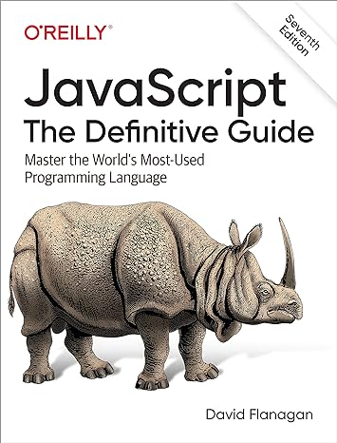
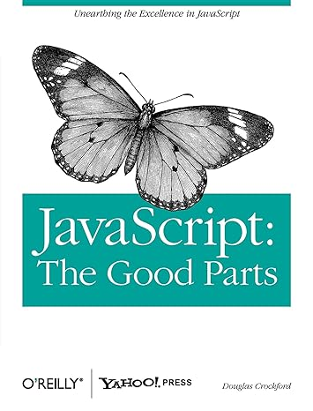
How large is the language?
704 pages
174 pages

Slide 7
Executing JavaScript

Slide 8
Running JavaScript code
In the Web browser
  Create an HTML page
  Embed a <script> element
  Attach callbacks to
    HTML elements
    Events and changes of state
On a server
  Install a server such as Node, Deno, or Bun
  Either
    Write a full application that uses the facilities of the server
    Use a framework such as Express or React

Slide 9
Performance
JavaScript is fast enough
JavaScript is an interpreted language with a just-in-time compiler
JavaScript engines in browsers are able to produce and execute incredibly fast code
  Chrome V8
  Firefox SpiderMonkey
  Safari JavaScriptCore (aka Squirrel, Nitro)
Servers such as Node are equally fast
The largest delays in any program are due to
  Latency of the network
  The size of resource being manipulated
  Management of state

Slide 10
Lists

Slide 11
Using lists
const values = ["first", "second", "third", "fourth", "fifth"];
console.log("The array has "+ values.length +" elements.");
values.forEach((item) => {
console.log(item)
});
const valuesInUppercase = values.map((item) => item.toUpperCase());
console.log(valuesInUppercase);
const filteredValues = values.filter((item) => item > "first");
console.log(filteredValues);

Slide 12
Using lists
Immutable data structure
const values = ["first", "second", "third", "fourth", "fifth"];
Lambda function
values.forEach((item) => {
console.log(item)
});
Map not iterate
const valuesInUppercase = values.map((item) => {
item.toUpperCase()
});

Slide 13
Functions

Slide 14
Define a function
Functions can be defined in the way that is familiar in languages like Java
Eich was asked to build javaScript as a scripting version of Java
  Remember the languages have no actual relationship
This code is standard imperative stuff
function celsiusToFahrenheit(temp) {
return ((temp * 9) / 5) + 32;
}
console.log(celsiusToFahrenheit(100));

Slide 15
Define a function
You can define a function in a similar way to Clojure’s let
const celsiusToReamur = function (temp) {
return temp * 0.8;
}
console.log(celsiusToReamur(100));
Or use a fat arrow
const reamurToCelsius = (temp) => {
return temp * 1.25;
}
console.log(reamurToCelsius(80));
Note the use of const to make these immutable

Slide 16
Hoisting
Functions can be used before they are defined
All functions are added to a global object called Variable
  This adds functions to the global namespace
Need to take care when adding functions to a class prototype
This process is called hoisting
Methods are members of classes
Using the newer class syntax means they are not hoisted

Slide 17
Functions as arguments
JavaScript has higher-order functions
  These can receive functions as arguments which they then call
  Or return functions
const converter = (value, from, to) => {
return to( from(value) );
}
console.log(converter(100, reamurToCelsius, celsiusToFahrenheit));
Notice that we don’t use parentheses when we pass the function
The functions passed in are called callbacks

Slide 18
Currying
Currying is the process of
  Taking a function that receives multiple arguments
  Changing it to a set of functions each receiving a single argument
function curriedDot(vector1) {
return function(vector2) {
return vector1.reduce((sum, element, index) => sum += element * vector2[index], 0);
}
}
// Taking the dot product of any vector with [1, 1, 1]
// is equivalent to summing up the elements of the other vector.
const sumElements = curriedDot([1, 1, 1]);
console.log(sumElements([1, 3, -5])); // -1
console.log(sumElements([4, -2, -1])); // 1

Slide 19
Other functional ideas

Slide 20
Recursion
Here is a recursive function to calculate a factorial
In some browsers this will blow the stack if called with a sufficiently large argument
const recursiveFactorial = (n) => {
if (n === 0)
return 1;
else
return n * recursiveFactorial(n - 1);
}
console.log(recursiveFactorial(27));

Slide 21
Tail call optimisation
The ECMAscript 6 standard (AKA ES2015) introduced proper tail-call optimisation
If a function just calls itself and returns the result stack frames can be omitted
const factorial = (n, product=1) => {
if (n === 0)
return product;
else
return factorial(n-1, product*n)
}
console.log(factorial(27));

Slide 22
Closures
A closure is formed when a function can access data from outside its own scope
Functions accessing global variables are closures
function makeAdder(x) {
return function (y) {
return x + y;
};
}
const add5 = makeAdder(5);
const add10 = makeAdder(10);
console.log(add5(2)); // 7
console.log(add10(2)); // 12

Slide 23
Closures
In that example makeAdder is a factory that makes functions that add a specific value to their argument
Closures mean that you can easily associate data with a function that operates on that data
  Broadly the same as a class that has just one method
This is especially useful in Web development
  Handling events on the browser with callbacks
You’ll often see nested callbacks that create a block scope over their data
https://developer.mozilla.org/en-US/docs/Web/JavaScript/Closures

Slide 24
ut einde
(Limburgish)

